Slide 1


Green Pace
Security Policy Presentation
Developer: Shawn Way
Notes:
Welcome everyone. Today, we will be going over the security policy for Green Pace.

Slide 2

OVERVIEW: DEFENSE IN DEPTH
Our security policy has been put in place to help us build more secure software. This policy details how we will implement defense in depth as depicted below.
Notes:
Defense in depth is the practice of using multiple layers of security to ensure that an attack cannot penetrate far enough in the system to cause any real damage. As you can see below, there are quite a number of layers necessary to successfully implement this practice.

Slide 3
THREATS MATRIX
Likelihood: How likely the treat is to lead to an attack.
Priority: Necessity of a remedy.
* There are some threats that were evaluated to medium priority and probable risk.
Likely Division by Zero String Overflow SQL Injection Freed Memory Access Unhandled Exceptions | Priority String Overflow Freed Memory Access Unhandled Exceptions Uninitialized Variables
Low priority Mishandled Assertions Unclosed Files | Unlikely Mishandled Assertions Unclosed Files
Notes:
This threat matrix shows the breakdown of risks as categorized by likelihood and priority. Likelihood is a measurement of how likely the threat is to lead to an attack. The priority is a measurement of the necessity for the threat to be remedied. In the matrix we find the threats divided by these criteria. Note, there are threats in the security policy that are of intermediate priority and likelihood.

Slide 4
10 PRINCIPLES
Validate Input Data
Heed Compiler Warnings
Architect and Design for Security Policies
Keep It Simple
Default Deny
Adhere to the Principle of Least Privilege
Sanitize Data Sent to Other Systems
Practice Defense in Depth
Use Effective Quality Assurance Techniques
Adopt a Secure Coding Standard
STD-001-CPP: 3, 9
STD-002-CPP: 1, 2, 9
STD-003-CPP: 1
STD-004-CPP: 1, 5, 7, 8
STD-005-CPP: 2, 3
STD-006-CPP: 10
STD-007-CPP: 2, 10
STD-008-CPP: 6
STD-009-CPP: 2, 10
STD-010-CPP: 2, 3, 10
Notes:
The 10 principles upon which this security policy was based are listed here, and the coding standards are listed in conjunction with the principles with which they are best aligned. Validating input data is the process of ensuring that user input cannot cause harm, inadvertently or otherwise. It is important to heed compiler warnings because they will be the first line of defense in finding security bugs and vulnerabilities. To facilitate this, the compiler should be set to verbose. Architecting and designing for security policies is about weaving security into the very fabric of the software from the ground up. Security should not be left to the end but implemented as an intrinsic property of the design. Keeping it simple is just what it sounds like. Complexity for its own sake only confuses the team and leads to unmaintainable issues and vulnerabilities. If it is not necessary to make the code difficult, favor simple and robust code. Default denial is the practice of disallowing permission and access to the user by default. In the unfortunate case that a malicious user finds a way to circumnavigate authentication, they will be given no authorizations by default. Adhering to the principle of least privilege is similar to the last principle, but it focuses more on the practice of giving the authorized user only the minimum number of privileges necessary for them to accomplish the tasks they set out to perform. Sanitizing data sent to other systems is similar to validating input data. It is important to sanitize data before it is sent and validate data as it arrives so that security is upheld at both ends. Practicing defense in depth entails humility and the foresight to understand that hackers will find ways to penetrate even the best systems. Layering defense ensures that these partially successful attacks never become totally successful attacks that lead to truly harmful effects. Using effective quality assurance techniques is about making sure that the code is robust and well written. Good code is generally more secure code. Adopting a secure coding standard is important to ensure that we are all working towards the same goal of security in the same way. A standardized approach will enable Green Pace to have a uniform level of security.

Slide 5
CODING STANDARDS
Ensure sufficient storage for character data and the null terminator
Do not access freed memory
Handle all exceptions
Do not read uninitialized memory
Ensure that type conversions do not result in a loss of data
Ensure that division by zero cannot occur
Validate user input before using SQL queries
Do not delete a polymorphic object without a virtual destructor
Do not rely on assertions to verify condition
Close files when they are no longer needed
Notes:
These are the 10 coding standards. They have been listed in order of priority. The system used to prioritize these standards is based on the likelihood of being attacked, the severity of the damage that could be caused by the attack, and the remediation cost, which refers to the difficulty fixing the vulnerability would entail. Using this system of prioritization, we found vulnerabilities that were high, medium, and low priority, as the list is organized.

Slide 6
ENCRYPTION POLICIES
At Rest: Full disk encryption
In Flight: Encryption before transmission
In Use: Protection through Triple-A
Notes:
Encryption must be achieved throughout the 3 stages of data. These are at rest, in flight, and in use. Data at rest is in storage for later use. This data is usually the most valuable data but is also the most secure. Data in flight is being transmitted from one location to another. This data is more at risk than data at rest, but less than data in use. Data in use is the data that the user is interacting with directly. This data is at the highest risk due to its proximity to the user. Data at rest is encrypted through the use of full disk encryption. This ensures that any lost data is completely unreadable and inaccessible. Data in flight is encrypted before transmission to ensure that the data cannot be understood should it be intercepted. Data in use is secured through the use of a Triple-A framework, which we will go over in the next slide.

Slide 7
TRIPLE-A POLICIES
Authentication: Identifying the user
Authorization: Grant the user minimum access and permission
Accounting: Monitor the user’s activity while logged on
Notes:
Triple-A is a policy that entails authentication, authorization, and accounting. Authentication is the process of identifying the user. This may require things like multi-factor identification, the use of strong passwords, and physically identifying media, such as USB access keys. This step is important to ensure that the user is properly identified before authorization. Authorization is the process of granting the authorized user privileges. This must be done with the utmost care to ensure that the user is given the minimum level of privilege necessary. Accounting is the monitoring of user activity when they are logged in. Should a malicious user get through all other layers of security, they must be monitored in order to be caught. If no one is looking, no one can be caught.

Slide 8
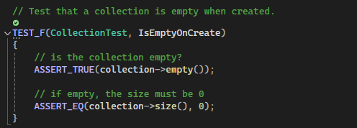
Unit Testing
IsEmptyOnCreate
Verifies that the collection is empty when first created.
Test Result: Positive
Notes:
In the next few slides, we will go over a set of unit tests to show how they can be used, what they can do, and how they show their results. Here we have a unit test verifying that a collection, which will be used for all of the following unit tests, is empty upon creation. Using assertions, the collection is verified to be empty and has a size of zero. The result for this test was positive, as evidenced by the console window output under the depicted unit test code.

Slide 9
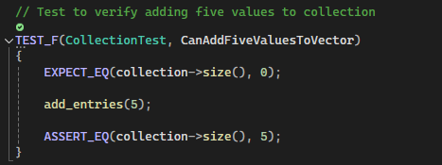
Unit Testing
CanAddFiveValuesToVector
Verifies that five values can be added to vector.
Test Result: Positive
Notes:
In this test, we ensure that it is possible to add five values to the vector in the collection. This is done using an expect and an assert function. The expect function would not stop the execution of the test, but it is there to verify that the collection is empty before the test is performed. This test was positive due to the fact that adding five values is supported by the collection.

Slide 10
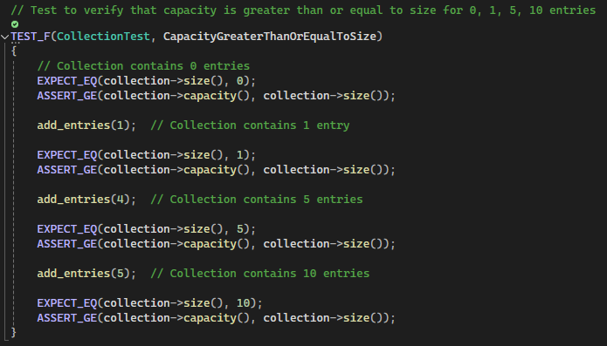
Unit Testing
CapacityGreaterThanOrEqualToSize
Verifies that the capacity of the collection is always greater than or equal to its size.
Test Result: Positive
Notes:
This next unit test verified that the capacity of the collection is always greater than or equal to its size. This is an important verification because it ensures that it is not possible for the collection to experience an overflow due to expansion of the data. The result of this test was also positive.

Slide 11
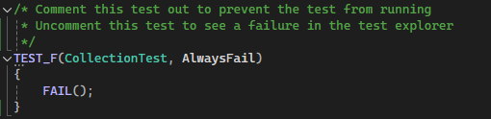
Unit Testing
AlwaysFail
Always fails to show how the unit testing framework reacts to failure.
Test Result: Negative (as expected)
Notes:
The final test is not a unit test that you would normally see in the unit testing routine, but it is included here to show what a negative result would look like in the printout from the console window. This test uses the fail function to force it to fail intentionally. The console shows the location of the failure in the system, and which test failed.

Slide 12

AUTOMATION SUMMARY
Notes:
This slide depicts a graphic to explain the automation process. First, we assess and plan so that we know what we will be designing for. Then, we begin designing the software. Right from the start, we should be designing security into the system. Then, we start building the software. This is where the bulk of the coding will reside, and we should compile often to catch issues long before they become buried. Next, we verify and test the code. This would, optimally, have been happening in the build phase as well, but now we will put the primary focus on verification and testing. This is where we will use unit testing and security verification tools like CppCheck. Transitioning and health checking is then performed so that the deployed software works correctly and is smoothly introduced to the market. We then monitor and detect issues so that they may be fixed as soon as possible. Should any bugs or vulnerabilities be found, or should any attacks happen, we will respond to them as part of this next phase. Finally, we will maintain and stabilize the software throughout its life to ensure that it maintains maximum availability, profitability, and security.

Slide 13
RISKS AND BENEFITS
Waiting leaves us open to attack, but change will not be easy.
Attempting to change overnight will cause massive issues
There will be an adjustment period necessary.
These policies will be rolled out over the course of the next quarter.
This will aid in training, adoption, and security.
Notes:
This security policy is fairly extensive. We must adopt it in order to secure our software, and waiting will only leave us open to attack for longer. In an ideal world, we could just immediately change over to following this policy, but it would also cause a severe number of issues for us to attempt to change overnight. This will mean that it will be necessary for us to observe an adjustment period. The policy will be rolled out over the course of the next quarter. Taking some time to switch over, though this is still an aggressive adoption of the standard, will allow time for training, the universal adoption of the standard, and an elevated level of security due to the well-established standard.

Slide 14
RECOMMENDATIONS
Currently, this standard does not address the nature of securing the number of devices that can access the network, both internally and externally.
There are a number of gaps in what is necessary to secure systems that need to access the cloud.
Notes:
No policy is ever perfect. Currently, this standard does not adequately address specific issues related to the use of various devices and the way that they change the nature of access to the network. There is also nothing that calls out the difference in security from external threats and internal threats. In our ever more data driven society, threats related to the use of the cloud and cloud-based applications are ever-increasing. There are gaps in this standard related to these kind of attack vectors.

Slide 15
CONCLUSIONS
In order to reduce the number of gaps that may arise in the future, it will be necessary to adopt a zero-trust policy.
Should our development shift to a more functional standard instead of OOP, there will need to be adjustment made to the policies.
Notes:
To eliminate the gaps in this standard and any future gaps that may arise as technology progresses, I believe it is best for us to adopt a zero-trust policy in the near future. This will allow our organization to secure each and every vector from which an attack may originate. Also, should we shift away from the more popular object-oriented programming standard and into a more functional paradigm, we may need to re-evaluate our coding standards to ensure that specific issues related to this paradigm are addressed. Thank you for your support as we go forward and implement this standard and thank you for your attention during this presentation.

Slide 16
REFERENCES
Carnegie Mellon University. (n.d.). Sei cert C++ coding standard. SEI CERT C++ Coding Standard - SEI CERT C++ Coding Standard - Confluence. https://wiki.sei.cmu.edu/confluence/pages/viewpage.action?pageId=88046682
Green, J. (2019, June 3). How zero trust improves security and the user experience. YouTube. https://www.youtube.com/watch?v=-Why_ZjJUhg
Notes:
Reference slide. No further voiced lines.

